Slide 1
Basic Linux Commands
P J Manu Prathap

Slide 2
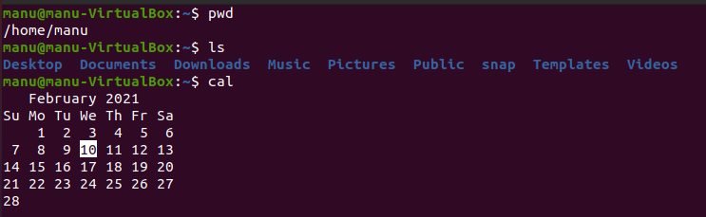
pwd : present working directory ls : list files cal : display calander

Slide 3
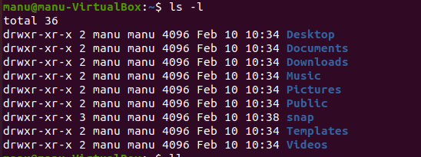
ls –l : list files with details ls –a : list all files including hidden files ls –a –l : list all files including hidden files with details

Slide 4
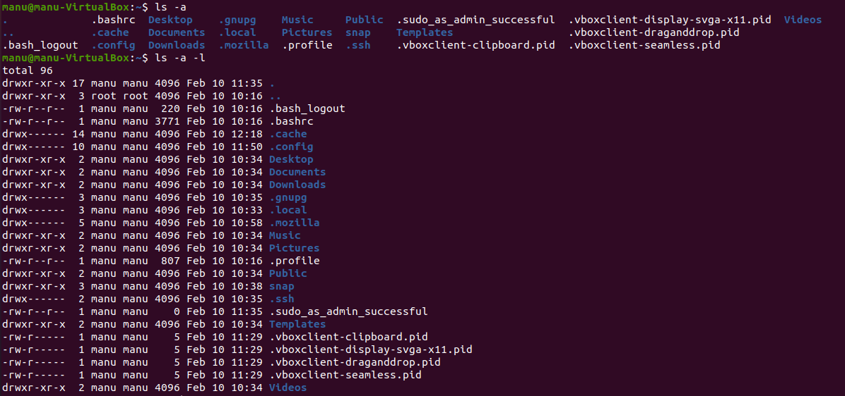
ll : list all files including hidden files with details
touch : create new file
cat : display file contents

Slide 5

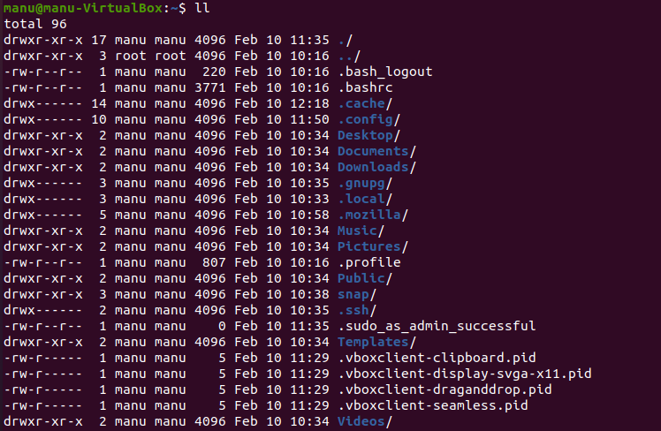

Slide 6
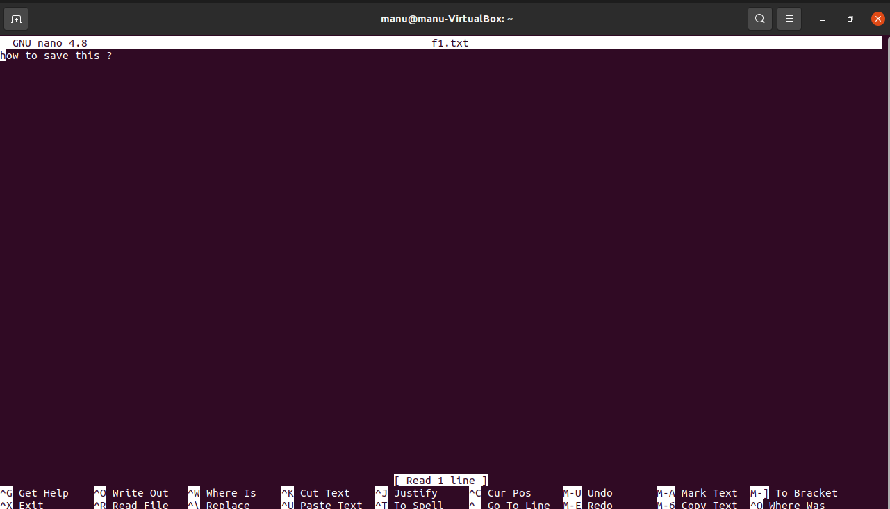
nano : opens nano editer,
“ctrl + s” to save & “ctrl + x” to exit

Slide 7
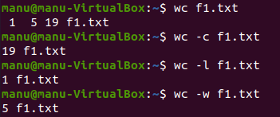
wc : line, word, character count
wc –c : character count
wc –l : line count
wc –w : wordcount

Slide 8
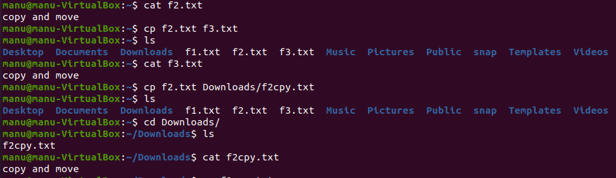
cp : copy

Slide 9
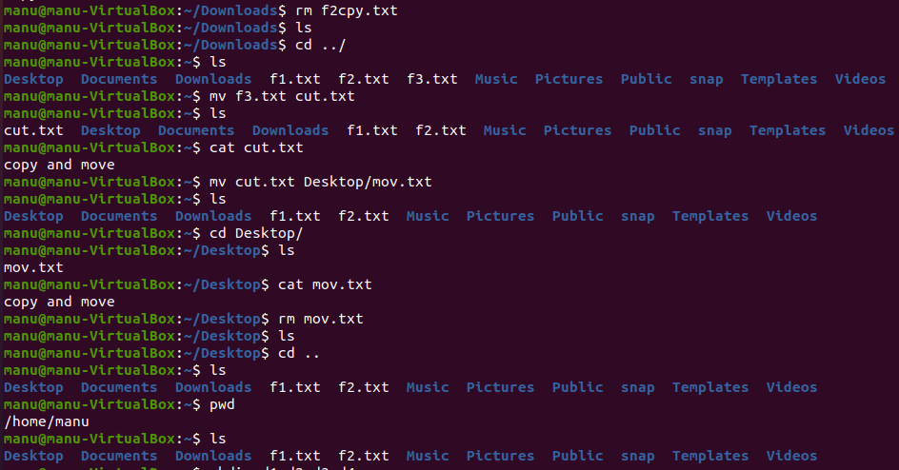
rm : remove file
mv : move

Slide 10
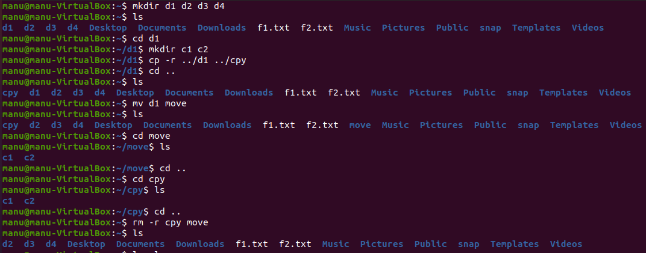
mkdir : make directory
cd : change directory

Slide 11
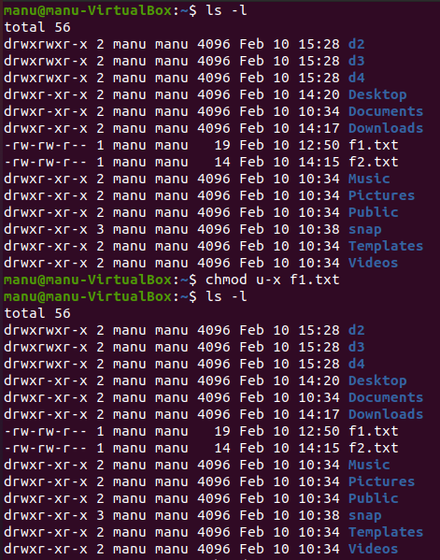
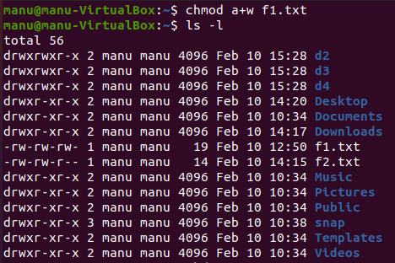
chmod : change permission
u – user, g – group, o – other, a - all
r – read, w – write, x – execute
“+ add, - remove, = set” permission

Slide 12
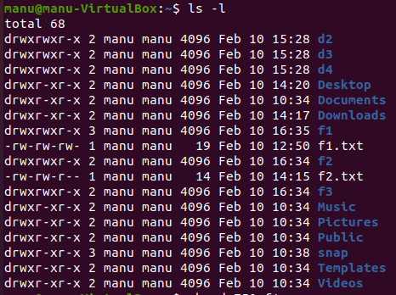
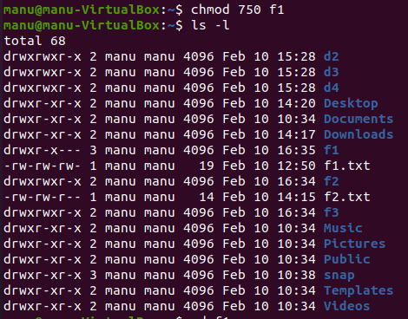
chmod using octal
0 – nil, 1- execute, 2- write, 3- execute&write, 4- read, 5 read&execute, 6- read&write, 7-all

Slide 13
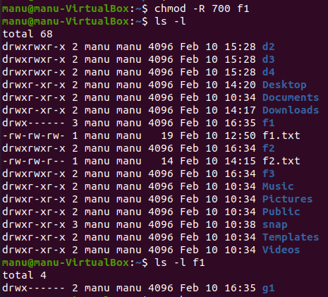

Slide 14
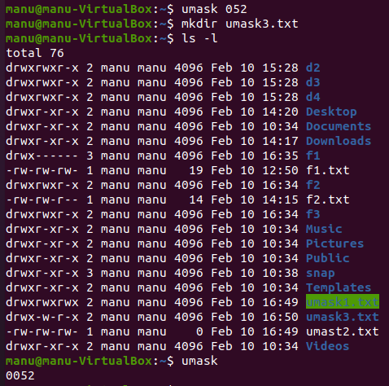
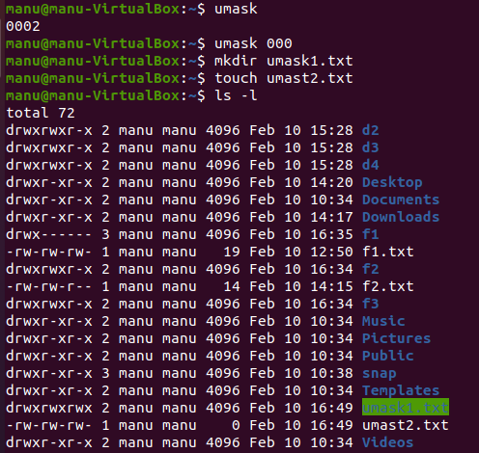
umask – used to set default permissions
calculated as “7777 - umask”

Slide 15
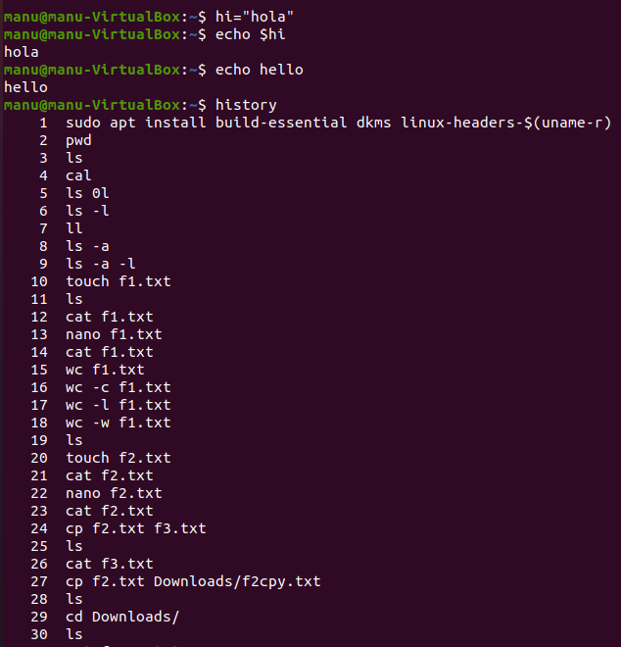
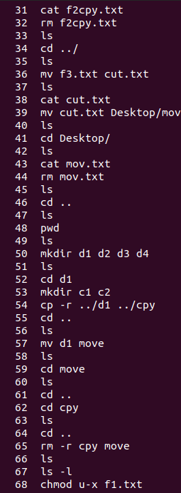
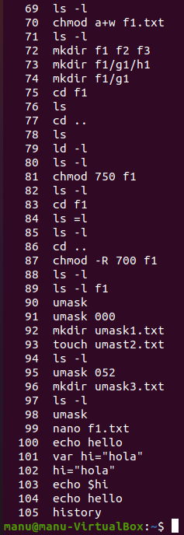
echo : print
setting variable : variable_name=“content”
history : list recenty typed commands

